Slide 1
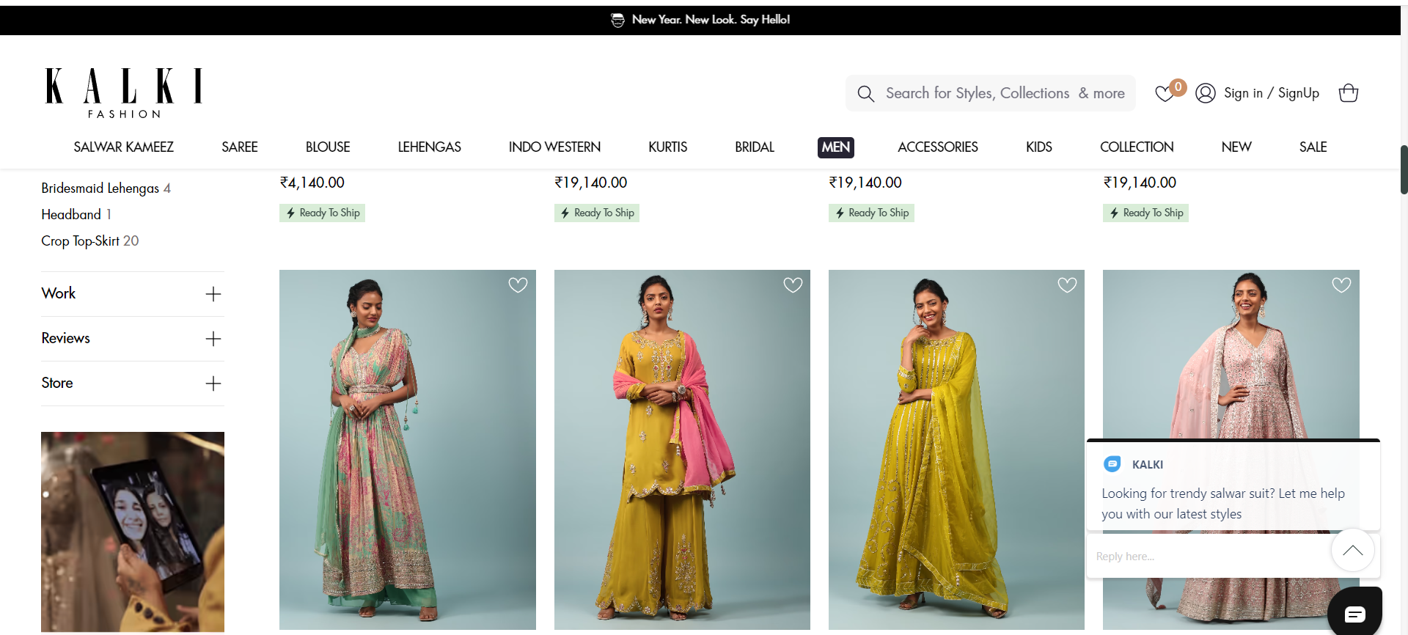
SEO Strategy
Salwar Kameez Kalkifashion.com

Slide 2
Contents
Page | Topic
3 | Keyword Research
4 | Targeting Subcategory Pages
5 | Navigation Optimization
6 | User Generated Content
7 | Conversion Optimization
8 | Schema Optimization
9 | Challenges

Slide 3
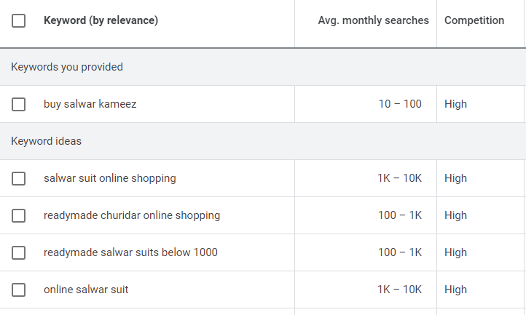
Keyword Research
Targeting buying intent keywords like “buy” or “online” keywords for the category pages.
Informational keywords can be used to target the blog pages.

Slide 4
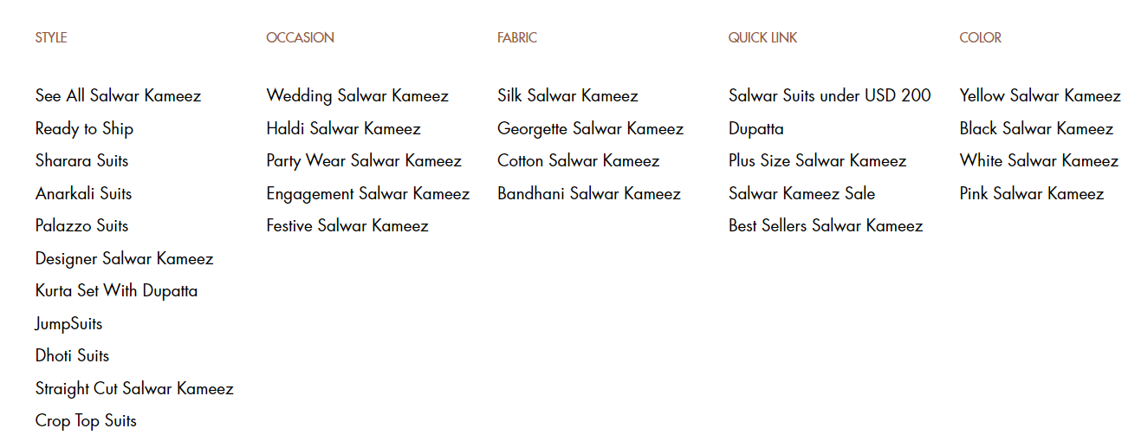
Targeting Subcategory Pages
Targeting the sub-category pages according to their respective keywords so to segregate the traffic for particular types of Salvaars properly.
Writing Titles and descriptions accordingly.

Slide 5
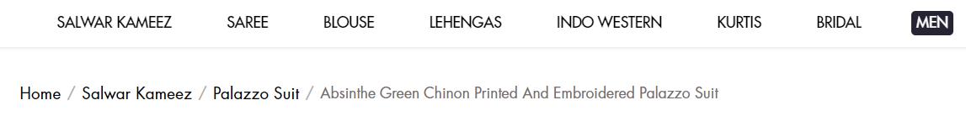
Navigation Optimization
Making Sure the category pages and product pages are easily navigable.
Adding breadcrumbs for faster access.
Ensuring URL and page hierarchy.

Slide 6
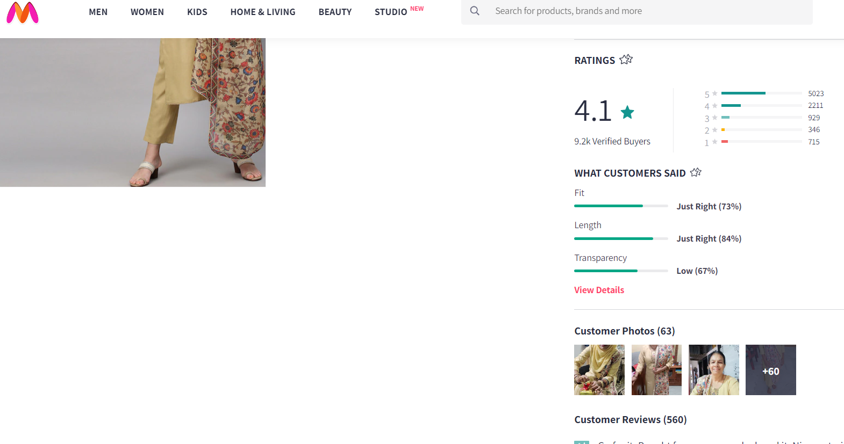
Adding User Generated Content
Product Ratings
Customer Reviews
User Generated content helps visitors buy products and get more information on the product.
This helps their buying decision and reduce buying time.

Slide 7
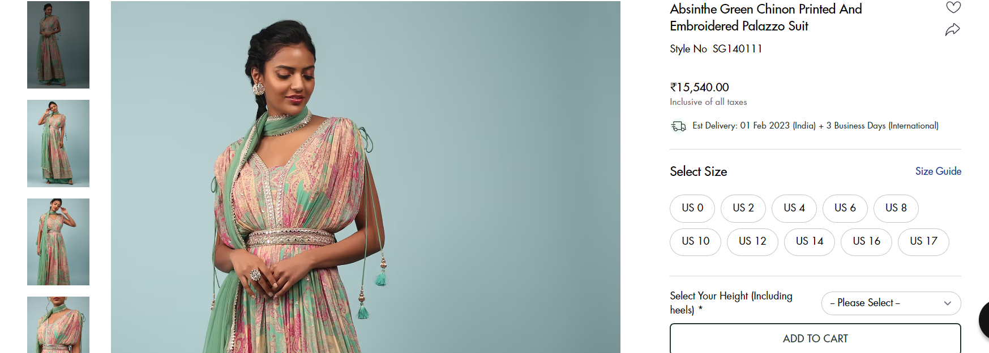
Conversion Optimization
Image Optimization
Ensuring the CTAs are working properly and properly placed.
Adding proper optimized images only
Optimizing the Product titles.
CTA

Slide 8
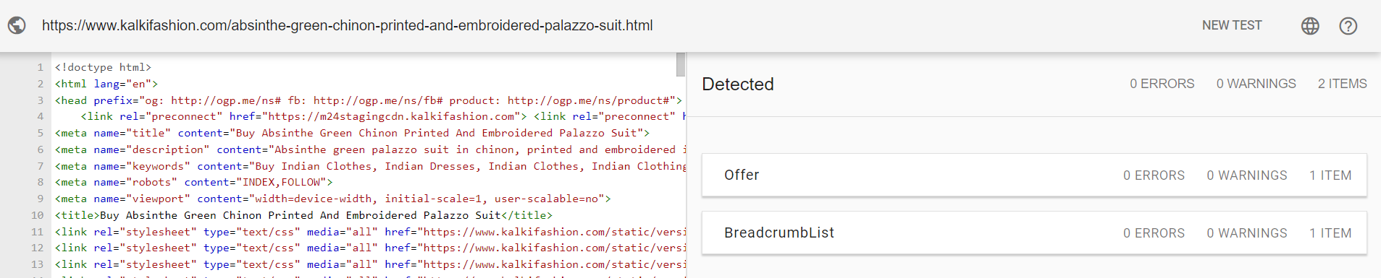
Schema Optimization
Product Ratings
Adding product schema on all the product pages.
Adding reviews schema on the products.
Adding breadcrumbs
Adding sitelinks schema
Offers schema

Slide 9
Challenges
Many images to be optimized as it’s an e-commerce website.
Schema will have to be checked individually on all the pages so that it can be optimized.
Keywords allocation for similar products.
Constant moderation of user generated content so as more amount of negative content isn’t posted.

Slide 10
THANK YOU

